Slide 1
The new Golden Rules
My Commitment, our Safety
Rev.0 – July 2022
Golden Rule 11
Hot Work

Slide 2
01.
The essentials

Slide 3
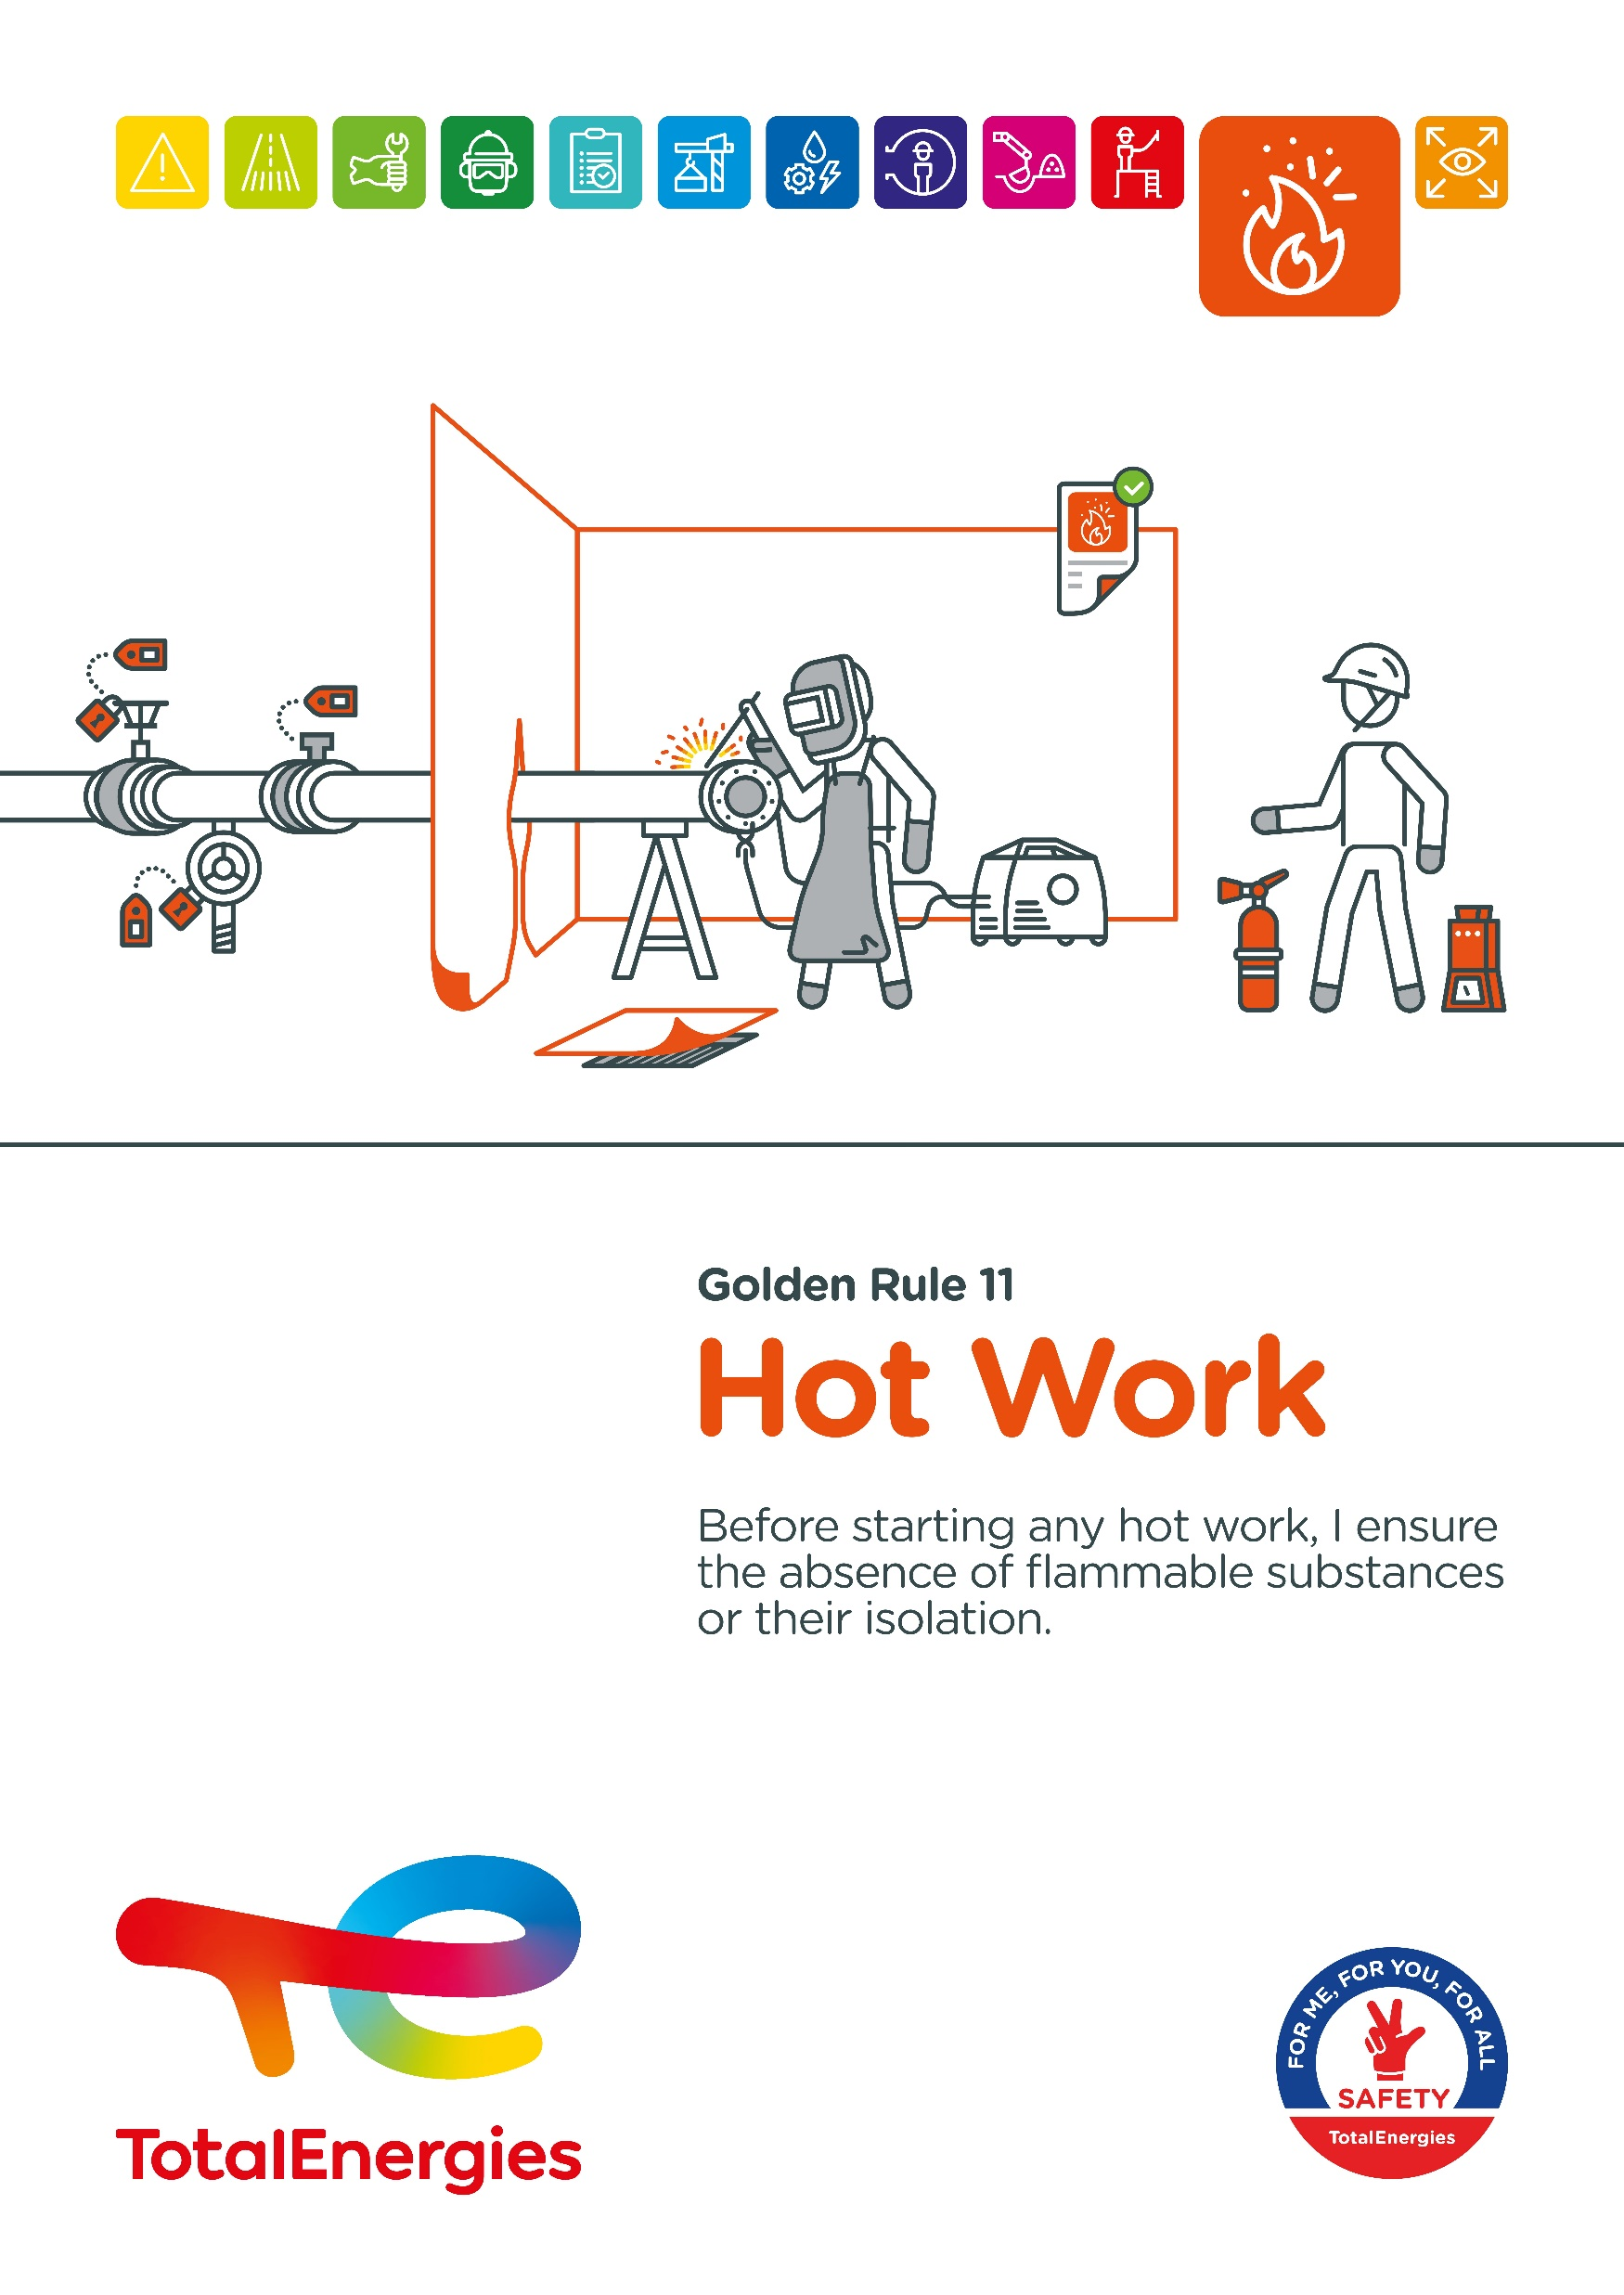
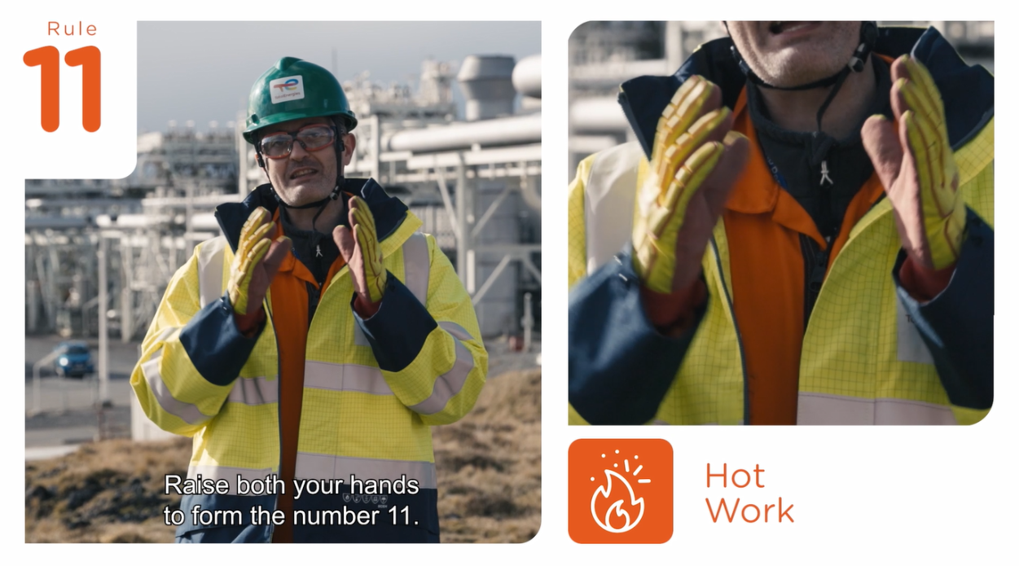

Poster & pictogram
Golden Rule 11 « Hot Work » is represented by a flame surrounded by sparks to indicate that a source of ignition is either visible open flames, sparks or any other hot spot.

Slide 4
Some definitions
HOT WORK
HOT WORK WITH OPEN FLAME
Any work using or likely to produce a source of ignition (with or without an open flame) capable of starting a fire or explosion.
Work requiring the use of open flames, producing sparks or heat, such as: flame cutting, welding, grinding…
HAZARDOUS AREA
HOT WORK WITHOUT OPEN FLAME
Any area where an explosive atmosphere (gas, dust) may occur in such quantities as to require special precautions to protect the safety of workers.
Work involving potential sources of ignition due to generated temperatures or internal arcing such as:
  Use of hand or power tools capable of producing a spark.
  Use of non-ATEX or non-intrinsically safe (uncertified) electrical equipment: camera, computer, mobile phone...

Slide 5
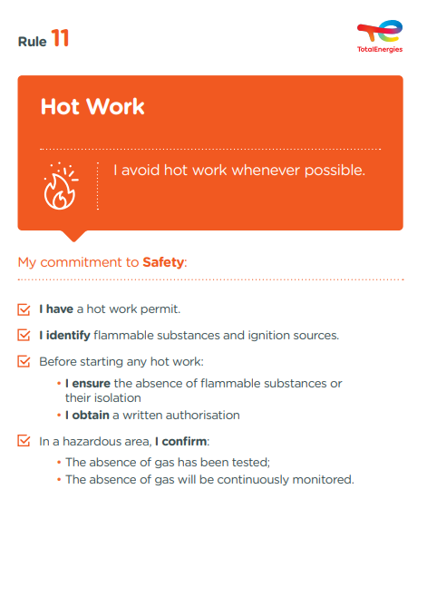
The essence of Golden Rule 11
The objectives of Golden Rule 11 include:
Reiterate that hot work should be avoided where possible.
Reiterate the need for a hot work permit (fire permit).
Ensure that everyone is aware of the environment in which they are working and has identified flammable substances and ignition sources.
Ensure that there are no flammable substances, or that they are isolated, before undertaking any hot work.
Remind people of the importance of measuring the atmosphere in the hazardous area before and during hot work.

Slide 6
Hot Work incidents
ACCIDENTS IN THE COMPANY WHERE A REQUIREMENT OF GOLDEN RULE 11 HAS BEEN BREACHED
EXAMPLES OF WORK SITUATIONS THAT COULD LEAD TO A FIRE OR EXPLOSION
2
Welding
Use of tools (hammer, spanner...) not adapted to the area
Fatalities*
10
Torch cutting
Bare cable
Lost time accidents**
19
Grinding
Non ATEX mobile phone
HIPO (High Potential)**
* Period 2012-2021
** Period 2017-2021

Slide 7
02.
REX

Slide 8
Illustration of requirements
REQUIREMENT | EVENT | SLIDE
1. I have a hot work permit. | IGNITION OF RESIDUAL GAS IN AN OPEN DRAIN CAISSON | N°9
2. I identify flammable substances and ignition sources. | FLASH WHEN CLEANING A SOLVENT TANK | N°10
3. Before starting any hot work: I ensure the absence of flammable substances or their isolation I obtain a written autorisation | EXPLOSION OF A GASOLINE TANK IN A DEPOT | N°11
4. In a hazardous area, I confirm the absence of gas has been tested. | SOLVENT AND WELDING TANK | N°12
4. In a hazardous area, I confirm the absence of gas will be continuously monitored. | START OF A FIRE | N°13
The descriptions of the circumstances and consequences have been simplified for a better understanding
A link to each REX is available for more information

Slide 9

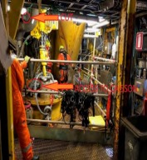
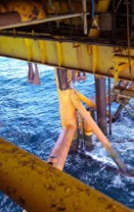
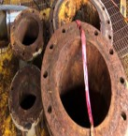
REX
1. I have a hot work permit
> IGNITION OF RESIDUAL GAS IN AN OPEN DRAIN CAISSON
CIRCUMSTANCES – FACTS
  In preparation for work above a caisson, the flanges of a pipe were left open to allow natural ventilation,
  When the pipe was being cut with a torch, a large explosion occurred,
  The cutting of the pipe above the caisson was not part of the planned work.
CONSEQUENCES
Potentially serious injuries (HIPO).
LESSONS TO BE LEARNED
I ensure that I have a dedicated hot work permit for my task.
I ensure that risk control measures including absence of gas testing are defined and implemented.
CAUSES
  Presence of gas inside the caisson not assessed - No check for absence of gas planned.
  Ignition and explosion of gas by sparks produced during cutting.
  Work not planned, therefore not covered by a hot work permit.
  Issue of a single work permit with a generic risk analysis for several activities in different areas.
Click here to access the REX

Slide 10
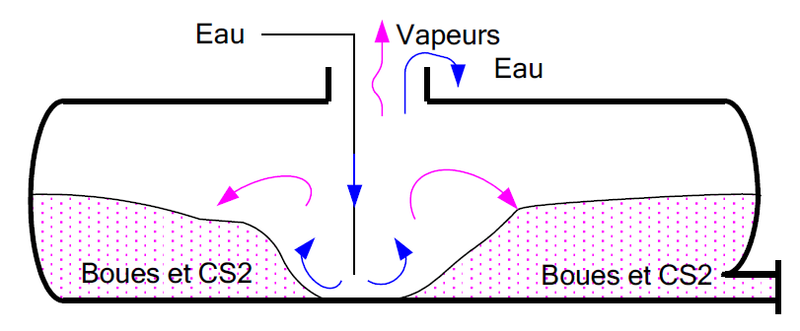
REX
2. I identify flammable substances and ignition sources
> FLASH WHEN CLEANING A SOLVENT TANK*
CIRCUMSTANCES – FACTS
  An exceptional operation to wash a used carbon sulphide tank had to be carried out.
  The tank was first emptied and a water purge was established.
  Sludge and vapours were then observed at the tank openings.
  Despite this unforeseen situation, the HP cleaning started.
  A worker inspected the tank for the effectiveness of the HP cleaning with a torch and then resumed the cleaning.
  After a break, he inspected the tank again with his torch.
  A flash occurred and the worker was caught in the flames.
CONSEQUENCES
Death of the worker.
LESSONS TO BE LEARNED
  I use tools designed for use in potentially explosive atmospheres and in good condition.
  I identify flammable substances and mark out the hazardous area.
  I measure the atmosphere in the hazardous area.
  I ensure that the work area is secured and suitable for hot work.
CAUSES
  Carbon sulphide is highly volatile and highly flammable:
    Vapours were released from the sludge during cleaning.
    An explosive atmosphere was therefore created.
  Contrary to what was planned, the explosivity was not checked.
  The waterproof lamp used was not designed for explosive atmospheres.
1
Water
Vapours
2
Water
CS2 vapours
Sludge & CS2
Sludge & CS2
Sludge & CS2
*Event prior to 2012
Click here to access the REX

Slide 11
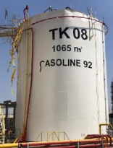
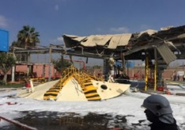
REX
3. Before starting any hot work: I ensure the absence of flammable substances or their isolation and I obtain a written autorisation
> EXPLOSION OF A GASOLINE TANK IN A DEPOT
CIRCUMSTANCES – FACTS
  Welding work was in progress on the roof of a gasoline tank.
  A spark probably fell into the tank.
  An explosion occurred.
  The roof was blown off and landed 40m away, taking with it the workers who were working on the tank
CONSEQUENCES
2 deaths and 4 seriously injured.
LESSONS TO BE LEARNED
I ensure that the tank is locked out (isolated, locked, de-gassed) and that a validated lockout certificate is attached to the hot work permit.
I ensure that an absence of gas test is carried out at the welding point before the hot work permit is issued.
I ensure that a gas detection device is deployed in the immediate vicinity of the hot work for the duration of the work.
CAUSES
  Welding work on the roof of a tank containing gasoline vapours.
  Lack of gas-free test inside the tank prior to the start of the welding operation.
  Premature removal of the isolation device while the work was not completed.
  Approval and authorisation to start hot work was given without field verification.
Click here to access the REX

Slide 12
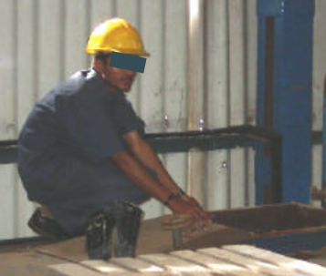
REX
4. In a hazardous area, I confirm the absence of gas has been tested
> IGNITION OF FUMES DURING WELDING WORK*
CIRCUMSTANCES – FACTS
  A worker was carrying out welding work under a tank.
  The tank, which had contained glue, had been cleaned with water several hours before.
  A film of glue still adhered to the walls of the tank and had released solvent vapours.
  These vapours were ignited by the heat of the torch, burning a supervisor positioned above the tank with a fire hose.
CONSEQUENCES
Burns to face and forearms (one week in hospital).
The tank could have exploded.
LESSONS TO BE LEARNED
The atmosphere is checked for flammable vapours using an explosimeter.
I confirm that the absence of gas was tested just before the work began.
Vapours can be heavier than air, so I make sure I measure the atmosphere in the right spot, for example using a pump and a dip tube.
CAUSES
  A film of solvent-impregnated glue covered the walls of the capacity and was not removed by washing with water.
  No explosivity test was carried out just before the start of the work.
  The vapours were ignited by the torch.
  No hot work permit.
Click here to access the REX
*Event prior to 2012
Position of the victim near the manhole

Slide 13
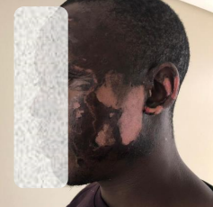
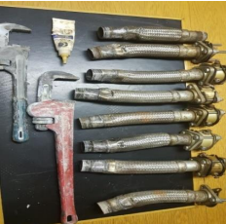
REX
4. In a hazardous area, I confirm the absence of gas will be continuously monitored
> START OF A FIRE
CIRCUMSTANCES – FACTS
  An operation to replace a non-return valve on a suction pump was in progress.
  The work area was partially confined and the maintenance work began.
  The worker encountered difficulties when dismantling the hose connected to the check valve.
  He used an adjustable spanner to unscrew the connection which had been fitted with sealing compound,
  A flash occurred.
CONSEQUENCES
Superficial burns to face - 1 week off work.
LESSONS TO BE LEARNED
Atmospheres are likely to change: the result of an atmosphere measurement at a given moment does not reflect the characteristics of the atmosphere throughout the operation.
I therefore ensure that the absence of gas is continuously monitored.
I use tools designed for explosive atmospheres: here the spanner was made of iron, the use of an ATEX spanner made of bronze or at least aluminium would have reduced the risk of sparking.
CAUSES
  Lack of identification of the risks associated with the use of non-ATEX tools (iron spanner).
  The continuous explosimeter monitoring planned for the operation was no longer in place.
Click here to access the REX

Slide 14
03.
Further information

Slide 15
Exemples of Hot Work
HOT WORK WITH OPEN FLAME
HOT WORK WITHOUT OPEN FLAME
Torch cutting, welding, grinding, brazing, milling, deburring, chiselling
Dry sanding, hot tapping
Use of smoking accessories (matches, lighters…)
Use of machine with burner or open flame
Heating with electric resistance
Heat treatment
…
Cathodic protection, wet blasting, static electricity generation
Extension cords without explosion-proof connectors, internal combustion engines, including motor vehicles and equipment
Opening live electrical panels or enclosures
Use of hand or power tools capable of producing a spark (wire brushes, compressed air or hydraulic tools)
Use of non-ATEX or non-intrinsically safe (uncertified) electrical equipment: camera, computer, mobile phone, use of multimeter, continuous gas detector...
Use of or work on equipment/facilities contaminated by pyrophoric deposits
…

Slide 16
Our tools and documents
Life Saving Checks – Hot work : Life saving checks
Program HSE Our lives first – Hot work : Theme 3 : Hot Work
Toolbox HSE – new Golden Rules :
    General material: TotalEnergies Golden Rules – General material
    Roll-out material: TotalEnergies Golden Rules – Roll-out material
REX database : Company HSE REX DataBase
Safety+ (good practices per Golden Rule) : https://safetyplus.totalenergies.com/en

Slide 17
Lexicon
Hazard: An intrinsic property of a product, equipment, process, situation or action that can result in harm to people, the environment and/or assets.
Risk: The combination of the probability of occurrence of a hazardous event and the severity of the impact that may result from exposure to the hazard.
HSE events:
  Incident: Any sudden and undesirable HSE event on a given date, that causes injury or illness, damage to property or facilities, loss of production, environmental damage or damage to the Company's image.
  Near miss: Any sudden and undesirable HSE event on a given date which, in slightly different circumstances, could have had the same consequences as an incident. A near miss does not have an actual severity level but has a potential severity level.
  Anomaly: Any abnormal situation or behaviour, including deviations from a standard, specification, procedure or rule.
HIPO (High Potential) [slide 6] : Incident or near miss with an actual severity level ≤ 3* and a potential severity level ≥ 4** in one or more areas of the Company’s evaluation matrix of the actual and potential severity level of HSE events.
REX HSE: Document for sharing information on an internal or external HSE event, based on a detailed analysis and making recommendations.
ATEX: The name is an initialization of the French term Appareils destinés à être utilisés en ATmosphères EXplosibles (French for "Equipment intended for use in explosive atmospheres").
* For example, physical consequences with an actual severity level = 3 correspond to a lost time accident.
** For example, physical consequences with a potential severity level of 4 correspond to a fatality.

